Slide 1

PREDII
WrenchIQ
An AI assistant monitoring your SMS & optimizing every repair order with you.
Like an owner coaching the service advisor and technician — on every RO.
PREDII CONFIDENTIAL | WRENCHIQ INTRODUCTION
Slide 1 · What WrenchIQ Is
Notes:
Thanks for the time — I know what an hour costs when the bays are full, so we'll keep this tight and get to a live demo quickly.
Looking to build on the discussion we had at dinner during the Auto Care connect week – this group – the Vehicle Service Experts – provided us with quite a bit of feedback, of real-world challenges and issues being faced every day, every week inside the shops –
we took that feedback and used it to refine some of the concepts we’ll share today around leveraging AI as, say, an Intelligence Layer alongside your current shop management system help to maximize revenue, margin and the customer experience.
One sentence on what you're about to see: WrenchIQ is an AI assistant that sits on top of the shop management system you already run and works every repair order with your team —
like you as a coach with every advisor and tech, on every ticket, all day.
Another key - It's not another screen to manage and not a replacement for your people. It sits in background and helps make the counter more effective - on every single RO.

Slide 2
THE SHOP FLOOR TODAY
Good People - Blind Spots Built Into the Day
1
2
3
Margin is invisible at the counter
Service recommendations & complete parts requirements often depend on who's working
Priorities don't reach the RO
Advisors build estimates without seeing parts margin - it's only known at the month-end report.
Related repairs and due services get caught by your best advisors and often missed by everyone else.
The promo or margin push you set Monday is gone by Wednesday's full lobby and ringing phone.
WHY HASN'T YOUR SHOP SYSTEM CAUGHT THIS?
Shop management systems were built to record work, not interpret it - WrenchIQ fills that gap: leveraging AI to read the RO and surface evidence-based recommendations while the vehicle is on the lift and the customer is still in front of you.
PREDII CONFIDENTIAL | WRENCHIQ INTRODUCTION
Slide 2 · The Shop Floor Today
Notes:
Three blind spots — none of them are really people problems, but all of them are experienced throughout the day:
Margin is invisible at the counter. Your advisor builds the estimate with no view of parts margin. You find out at week –or month-end — too late to do anything about it in real time.
Key recommendations depend on who's working. Your best advisors catch the related repair and the recommended services that are due. But on their day off, or even on a really busy day - that could be work that walks out the door.
Your priorities don’t always survive the week. The promo you asked to push Monday morning is often gone by Wednesday's full lobby and a stack of daily priorities.
A question you may think about - why hasn't my shop system caught this?
Mainly because the SMS was built to record work, not read it.
WrenchIQ, however, reads the RO while the vehicle is still on the lift and the customer is still standing in front of you — and that timing is the whole product.

Slide 3
WHAT IT DOES
Three Jobs, Done in Real Time on Every RO
JOB 1
JOB 2
JOB 3
Intake & Diagnosis Intelligence
RO Narration & Customer Trust
Evidence-based Recommendations & Owner's Priorities
Reads each RO as it's written and recommends related repairs, due maintenance, and TSBs for that exact vehicle.
Auto-writes clear complaint–cause–correction stories and customer talk tracks — because techs aren't writers.
Surfaces context-aware recommendations and keeps your priorities front & center - promos, programs, margin targets - on every ticket.
Higher average RO · Fewer comebacks
More approvals · Stronger trust
Margin lift · Priorities on every RO
PREDII CONFIDENTIAL | WRENCHIQ INTRODUCTION
Slide 3 · What It Does
Notes:
Key WrenchIQ activity being done in the background for every RO:
Job 1 — Intake & diagnosis intelligence. It reads the RO as it's written; recommends related repairs, due maintenance, and TSBs for that exact vehicle.
What that means for you: higher average RO and fewer comebacks — the work gets caught during the initial visit, by whoever's at the counter regardless of experience level.
Job 2 — RO narration & customer trust. WrenchIQ auto-writes the complaint–cause–correction story (the CCC’s) and gives the advisor a plain-English talk track.
Techs are great mechanics but often not-great writers or communicators - a clear, confident story to the customer is the difference between “let me think about it” and “yes, go ahead.” More approvals, stronger trust.
Job 3 — Evidence-based recommendations & your priorities. Every recommendation is backed by what the vehicle actually shows —
customers can feel the difference between a pitch and a finding supported by data. And your margin targets and promotions ride along on every ticket, not just Monday when it is fresh in their minds.
Bottom line: It’s about getting your best advisor's judgment & attention, on every shift, on every RO..

Slide 4
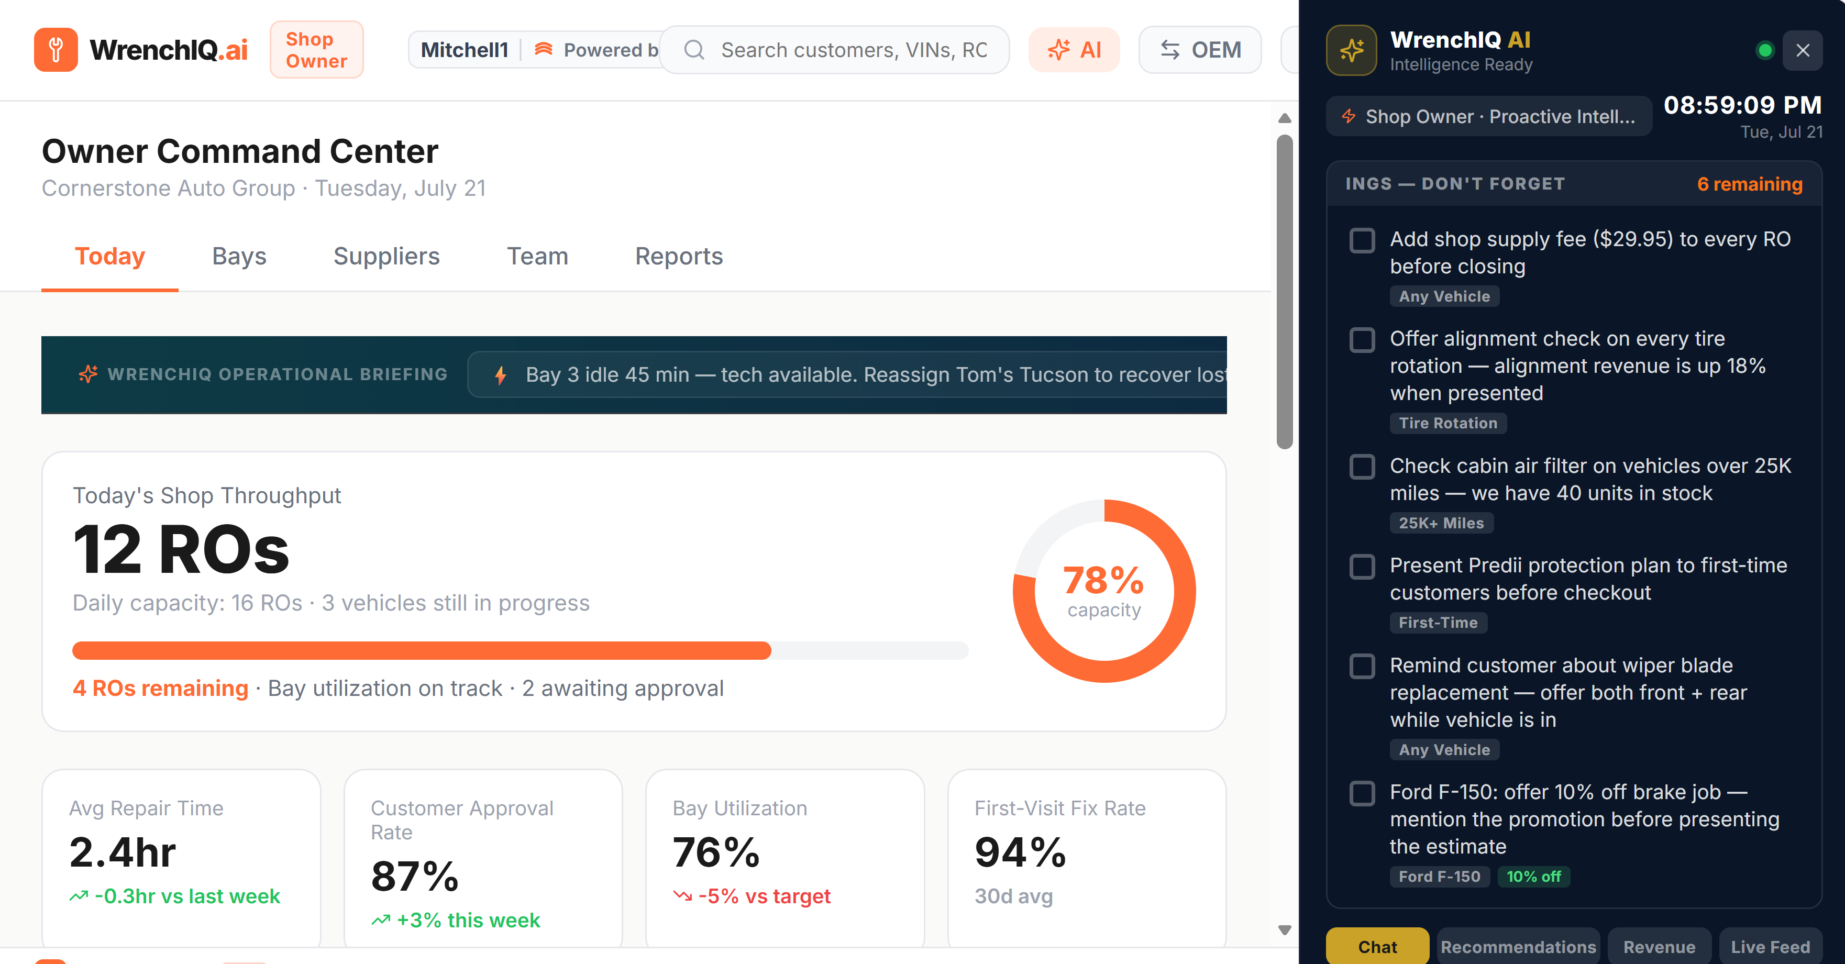
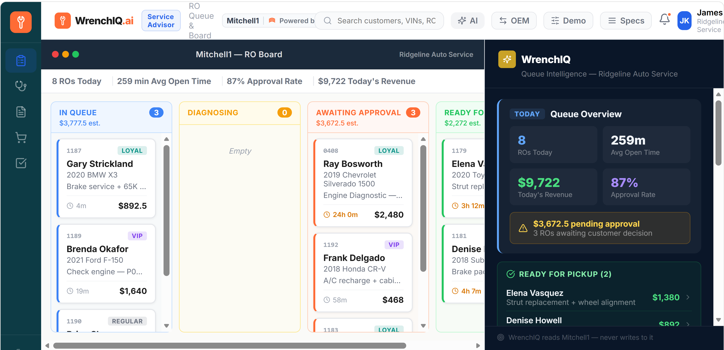
HOW IT WORKS
It Reads the RO and Speaks Up - No New Workflow
1
2
3
4
Advisor writes the RO
WrenchIQ reads the feed
It speaks up in the moment
Advisor acts
In the shop management system you already use.
A silent intelligence layer running alongside it.
Recommendations, margin flags & priority reminders.
The human always makes
the final call.
PREDII CONFIDENTIAL | WRENCHIQ INTRODUCTION
Slide 4 · How It Works
Notes:
Just showing here a high-level flow of what the Intelligence Layer is doing behind the scenes….
perhaps equally important is what it’s not doing: no new system, no new logins, no heavy retraining at the shop level, no change to how your advisors write an RO today. Simply assisting within the current SMS workflow.
Advisor writes the RO in the SMS you already use.
WrenchIQ reads the feed silently alongside of it.
It speaks up in the moment – making any needed recommendations, providing margin flags in real time, giving reminders based on your specific weekly priorities.
Finally - your advisor makes the ultimate call. Always. The AI advises; your people decide.

Slide 5
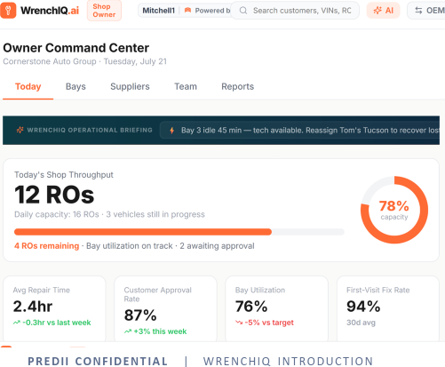
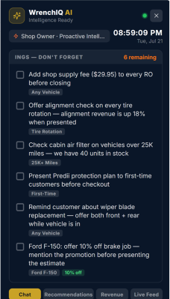
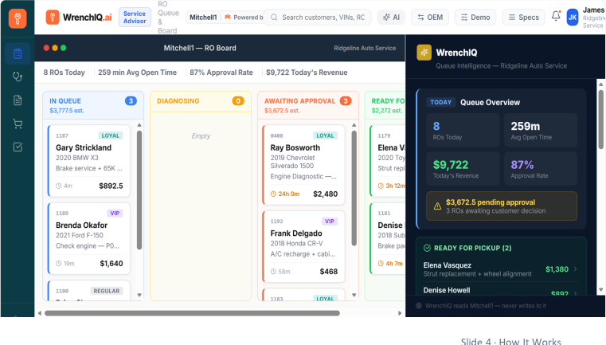
HOW IT WORKS
It Reads the RO and Speaks Up - No New Workflow
1
2
3
4
5
Shop owner sets priorities
Advisor writes the RO
WrenchIQ reads the feed
It speaks up in the moment
Advisor acts
Intelligence layer monitoring each RO being executed.
In the shop management system you already use.
A silent intelligence layer running alongside it.
Recommendations, margin flags & priority reminders.
The human always makes the final call.
PREDII CONFIDENTIAL | WRENCHIQ INTRODUCTION
Slide 4 · How It Works

Slide 6
TODAY'S DISCUSSION
Your Feedback - and Where We Go Next
WHAT WE'D LIKE FROM YOU
POSSIBLE NEXT STEPS
Do we hit the right use cases?
A low-lift pilot on your own ROs
Does this fit how your shop actually runs day to day?
Run WrenchIQ alongside a real workflow, measured against the numbers you already track.
How should it be delivered?
Interested in signing up for a POC?
What would it take for this to work naturally on your floor?
The value proves itself on your floor before anything changes.
Benefit, cost & commercials
What else should we build?
What's the value by use case — and what would fair pricing look like?
Your ideas and recommendations shape where WrenchIQ goes next.
PREDII CONFIDENTIAL | WRENCHIQ INTRODUCTION
Slide 5 · Today's Discussion
Notes:
Bottom Line: You run shops; we build AI. We need your thoughts and feedback.
As we move to the demo…we’re looking for thoughts around things like:
Did we hit the right use cases — or are there a bigger daily headaches we should chase first?
Does this fit how your floor actually runs?
How should it be delivered so it feels natural at the counter
And final bottom line: we’re actually in the middle of looking for partners in a low-lift pilot on real ROs — WrenchIQ running alongside a real workflow, measured against numbers you already track: average RO, approval rate, comebacks.
So if you’re interested in diving in more going forward, just let us know.
So just some things to think about as Tilak talks through the high-level overview and demo…
One note – while I say “demo” – it’s difficult to really fully demo this as it would work in the real-world…but we’re hoping to give you a good representation of how WrenchIQ would be fueled by your data and the management priorities you set, and then monitor the RO execution making recommendations when it sees and opportunity for revenue, margin or customer experience optimization.
Any general thoughts or questions at this point before we move to a high level demo?
With that, I’ll hand it over to Tilak…

Slide 7
PREDII
Thank you.
Let's put WrenchIQ to work on your floor.
PREDII CONFIDENTIAL | WRENCHIQ INTRODUCTION
Slide 6 · Close

